Slide 1

Sinhgad College Of Engineering
Department Of Computer Engineering
Project Stage I Presentation
PROJECT TITLE :
Predicting Lumpy Skin Disease in Cattles Through Machine Learning
Presented by:
Akanksha Bhosale B1902304231
Suyash Ahiwale B1902304206
Ankit Kalyani B1902304299
Riya Khuspe B1902304306
Under the Guidance of :
Prof. Runal Pawar

Slide 2
Contents
Abstract
Introduction
Literature Survey
Problem Statement
Objectives
Algorithm
Methodology
System architecture
UML diagram
Conclusion
References

Slide 3
ABSTRACT
Lumpy Skin Disease (LSD) is a concerning and contagious viral disease affecting cattle, distinguished by symptoms like fever, reduced milk production, and infertility, leading to major financial repercussions. To predict LSD infection in cattle with high precision, we aim to deploy machine learning. To achieve an F1 score of 98% and make them the most effective in detecting infected cattle, approximately ten classifiers will be trained on disease data with Random Forest and Light Gradient Boosted Machine (LGBM).
For evaluating an accurate prediction of LSD occurring due to environmental conditions, we will feed these features into machine learning models. A machine learning model called the Convolutional Neural Network (CNN) and ANN will be used for predicting disease occurrences. This model will provide a robust framework for predicting Lumpy Skin disease in cattle using machine learning.
Keywords: Lumpy Skin Disease (LSD), Random Forest, Light Gradient Boosted Machine, Artificial Neural Network (ANN), Forecasting, Disease Prediction.

Slide 4
Introduction
Overview of Lumpy Skin Disease (LSD) : Lumpy Skin Disease is caused by the Lumpy Skin Disease Virus (LSDV), a member of the Capripoxvirus genus. It primarily affects cattle, leading to symptoms such as fever, swelling of lymph nodes, skin nodules, infertility, and significant reductions in milk production.
Economic Impact : LSD has severe economic implications, including decreased productivity, increased veterinary costs, and trade restrictions. Outbreaks can lead to economic losses estimated in millions, affecting farmers and the agricultural economy.
Research Objective : The primary objective of this research is to develop a machine learning model that accurately predicts the occurrence of LSD in cattle based on available data. The study also aims to forecast potential outbreaks to facilitate timely intervention.
Importance of Machine Learning : Machine learning techniques allow for the analysis of large and complex datasets, improving the ability to identify patterns that traditional statistical methods might miss. These models can adapt and improve over time as more data becomes available, enhancing prediction accuracy.

Slide 5
Literature Survey
Sr. No. | Authors | Publication | Description
01 | E. ChandralekhaV. DeepaJemin V. MT. AnithaRavikumar S | 2023 | Predicting and Analysing Lumpy Skin Disease Using Ensemble of Machine Learning Models Seed idea: the paper explores the use of ensemble machine learning models to predict and analyze the spread of Lumpy Skin Disease (LSD) in cattle, focusing on the integration of geographical, climatic, and historical outbreak data.
02 | Vidur Sharma, Kushal Kanwar | 2023 | Lumpy Skin Disease Detector Seed idea : to automate the early detection of Lumpy Skin Disease (LSD) in cattle. This approach aims to improve disease management and reduce economic losses associated with manual inspections by leveraging image data for diagnosis.
03 | Anuj Kumar Jain, Raj Gaurang Tiwari , Neha Ujjwal | 2022 | An Explainable Machine Learning Model For Lumpy Skin Disease Occurrence Detection. Seed idea: to predict the occurrence of Lumpy Skin Disease (LSD) in cattle and water buffalo based on climatic and geographical data. The Random Forest algorithm, which achieved the highest accuracy, is further explained using SHAP visualizations to enhance model interpretability.

Slide 6
Problem Statement
This project aims to develop a machine learning model that accurately predicts Lumpy Skin Disease (LSD) outbreaks using visual data with the help of Convolutional Neural Networks(CNN) and Artifical Neural Networks(ANN), for better identification of disease by raw images of cattle.

Slide 7
Objectives
Develop a Machine Learning Model:
Construct a robust machine learning model to accurately predict the occurrence of Lumpy Skin Disease in cattle, utilizing historical disease data and relevant features.
Optimize Feature Extraction for Disease Detection:
Pre-process images of cattle to extract key visual features, improving the model's ability to distinguish between healthy and infected animals with minimal false positives.
Develop a Scalable System:
Ensure the model can scale to larger datasets, improving its accuracy and performance as more training data becomes available.
Validate Model on Diverse Data:
Train and test the model on a diverse dataset of cattle images to ensure its robustness and applicability in real-world conditions.
Evaluate Performance Across Algorithms:
Compare the performance of CNNs with other machine learning algorithms such as Random Forest or Support Vector Machines for detecting LSD in cattle, ensuring the most effective solution is deployed.

Slide 8
Algorithm
Random Forest :A powerful ensemble learning method that constructs multiple decision trees and aggregates their predictions to improve accuracy and control overfitting.
Example: For predicting with high accuracy and precision.
Light Gradient Boosted Machine (LGBM): An efficient gradient boosting framework that uses tree-based learning algorithms to optimize performance and speed, particularly on large datasets.
Example: Classifying cattle as healthy or infected with LSD using geospatial data.
Convolutional Neural Network (CNN):
A Machine learning model specialized for processing grid-like data, such as images, by using convolutional layers to automatically extract spatial features and patterns.
Example: Detecting Lumpy Skin Disease (LSD) in cattle by analyzing images of skin to identify visual characteristics associated with infection.
Support Vector Machine (SVM): A supervised learning algorithm that finds the hyperplane that best separates data points of different classes, effective for high-dimensional datasets.
Example: Classifying whether a cattle is infected or not based on various symptoms like red patches.
Artificial Neural network (ANN): Are computational models inspired by the human brain, designed to recognize patterns and make predictions based on input data.
Example: in the context of Lumpy Skin Disease (LSD) in cattle, an ANN can analyze the likelihood of disease occurrence.

Slide 9
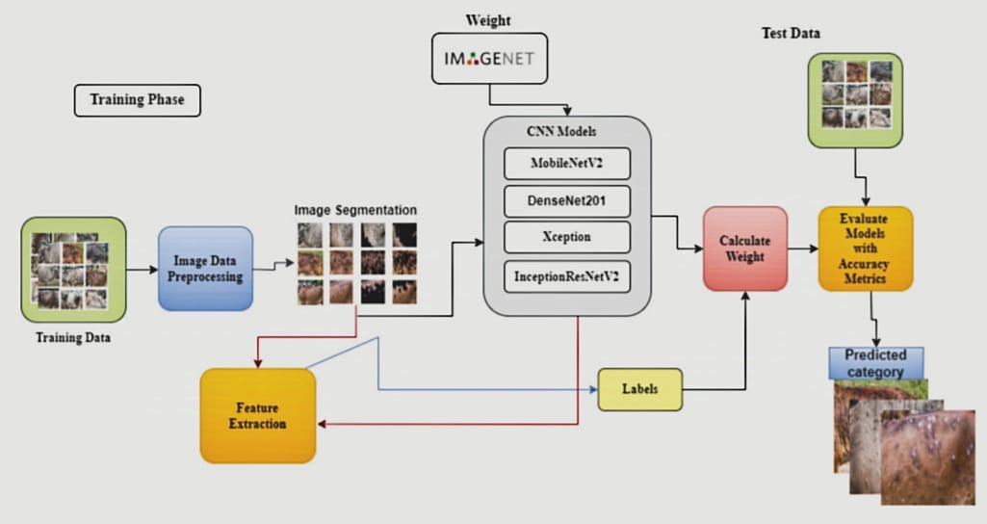
Methodology
Data is collected from various sources, including veterinary reports, online Public Datasets, Research Institutions.
Feature selection is performed using the Extra Trees Classifier to identify key predictors for LSD outbreaks.
Various machine learning classifiers, such as Random Forest, Light Gradient Boosted Machine (LGBM), and Convolutional neural networks(CNN), and ANN are employed to build the predictive model.

Slide 10
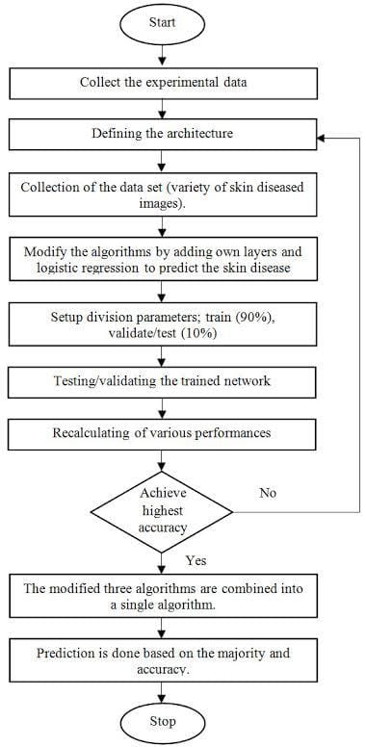
SYSTEM ARCHITECTURE

Slide 11
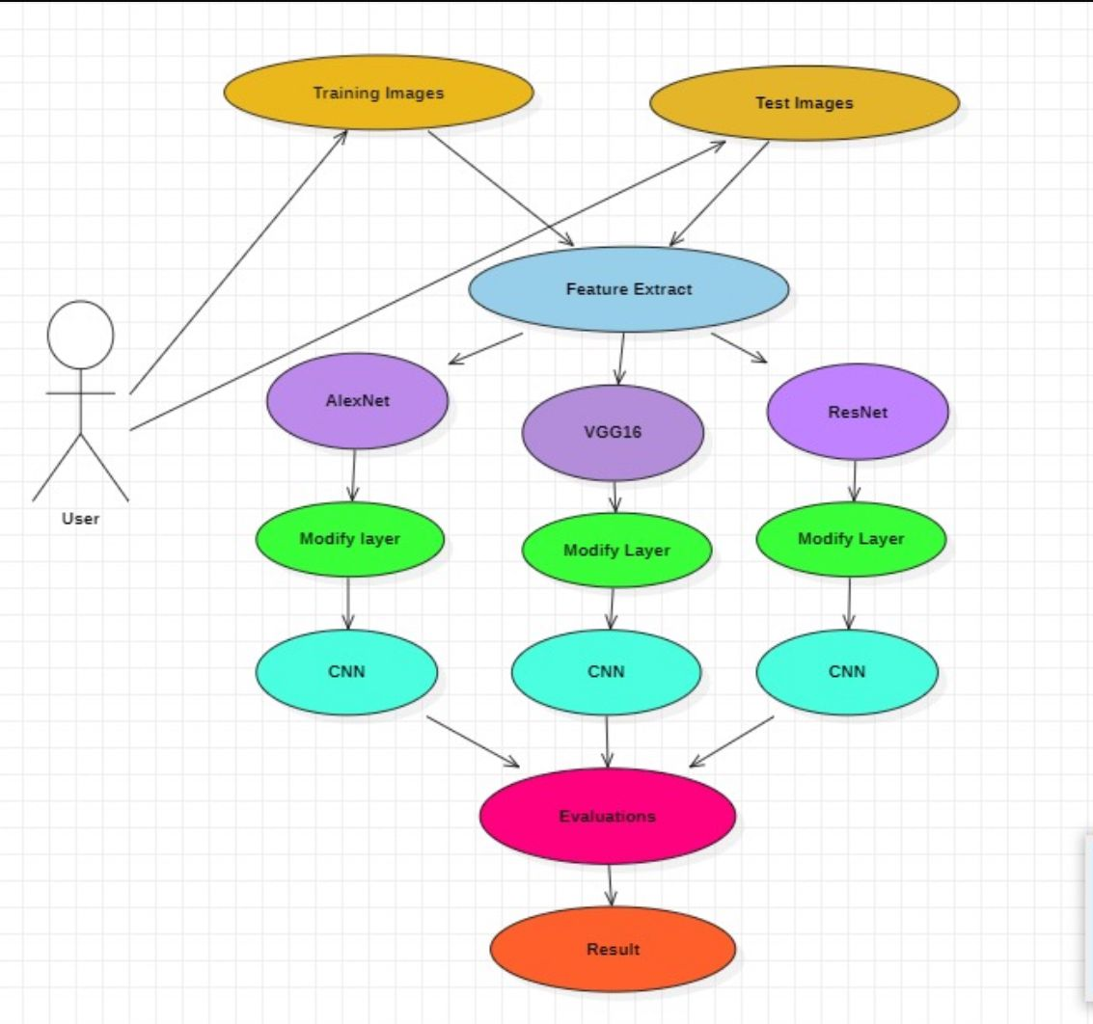
UML (Unified Modeling Language) diagram :

Slide 12
Conclusion
Effective Prediction of LSD
The project will successfully develop machine learning model that accurately predict the occurrence of Lumpy Skin Disease, demonstrating high performance with algorithms.
Accurate Disease Detection:
Demonstrated high accuracy in identifying LSD by analyzing visual symptoms in cattle, reducing the need for manual inspections.
Potential :
The technology has the potential to be adapted for detecting LSD diseases with visual symptoms, further advancing veterinary diagnostics.
Predicting Capabilities
The implementation of Prediction models enhances the ability to predict future outbreaks, allowing for measures that can mitigate the impact of the disease.
Future Scope
Future work can focus on integrating additional data sources, such as genetic information and animal behavior patterns, to improve model accuracy. Exploring real-time data analytics and developing a user-friendly application for farmers and veterinarians can further enhance disease management strategies.

Slide 13
References
[1] E. Chandralekha, et al. (2023). "Predicting and Analyzing Lumpy Skin Disease Using Ensemble of Machine Learning Models." 2023 Global Conference on Information Technologies and Communications (GCITC). DOI: 10.1109/GCITC60406.2023.10425950
[2] Vidur Sharma, et al. (2023). "Lumpy Skin Disease Detector." 2023 Seventh International Conference on Image Information Processing (ICIIP). DOI: 10.1109/ICIIP61524.2023.10537770
[3] A. Thakallapelli, S. Ghosh, S. Kamalasadan (2016). "Real-time frequency based reduced order modeling of large power grid." IEEE Power and Energy Society General Meeting. DOI: 10.1109/PESGM.2016.7741877
[4] W.H. Ahmed, et al. (2022). "Development of a machine learning model for the diagnosis of lumpy skin disease using clinical signs and symptoms." IEEE Access. DOI: 10.1109/ACCESS.2019.2923963
[5] Singh, et al. (2023). "Use of machine learning for the prediction of lumpy skin disease outbreaks." 2023 IEEE Conference on Data Analytics for Business and Industry (ICDABI). DOI: 10.1109/ICDABI56818.2023.9746456
[6] V. Deepa, et al. (2022). "A Study on Machine Learning Algorithms for the Prediction of Lumpy Skin Disease in Cattle." 2023 IEEE Conference on Data Analytics for Business and Industry (ICDABI). DOI: 10.1109/ICDABI56818.2022.9788995.
[7] G. Prakash, et al. (2023). "An Efficient Framework for Lumpy Skin Disease Detection in Cattle." 2023 IEEE International Conference on Image Information Processing (ICIIP). DOI: 10.1109/ICIIP61524.2023.10537770.

Slide 14
RATES OF LSD IN YEAR 2023-24 :
Lumpy Skin Disease (LSD) has impacted cattle globally, with a significant rise in cases across various regions, notably in India, Southeast Asia, and some African countries. In India, the 2022 outbreak resulted in a particularly severe impact, with over two million cattle affected and around 100,000 fatalities, largely due to the emergence of new, virulent strains and limitations in vaccine availability and distribution​.
In 2023-24, India has reported the highest prevalence and impact of Lumpy Skin Disease (LSD) globally, surpassing other affected regions. Since the 2022 outbreak, India has faced severe challenges, with over two million cattle infected and approximately 100,000 fatalities recorded, due in part to the circulation of new virulent strains and vaccine limitations​. LSD prevalence in India reached approximately 11-14% in cattle populations.
Africa generally saw a higher average prevalence, with certain countries experiencing rates around 20%, largely due to less stringent disease controls and vaccination access limitations. Specifically, countries like Kenya and Ethiopia experienced higher prevalence rates due to optimal conditions for disease-spreading vectors and challenges in animal health infrastructure.
In contrast, the Middle East also reported significant outbreaks, but countries in this region, such as Turkey and Jordan, implemented extensive vaccination programs and containment measures, leading to a more controlled spread. Rates across Europe and Central Asia, where LSD has also emerged, were lower, averaging below 5-10%, mainly due to strict regulatory controls and advanced monitoring systems​.

Slide 15


